Slide 1
Web Application
Using Django
Part I

Slide 2
Web Applications
A Web application (Web app) is an application program that is stored on a remote server and delivered over the Internet through a browser interface
A website can have one or many web apps each performing a unique specific task
For a web app to operate, it needs a web server, application server, and a database.
Web apps can have a client-side programming using languages such as Javascript, HTML5 or CSS
The server-side programming is done in languages such as Python and Java

Slide 3

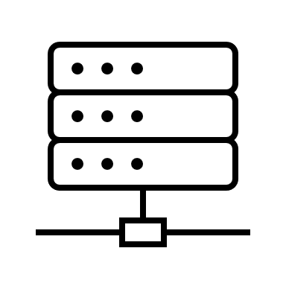
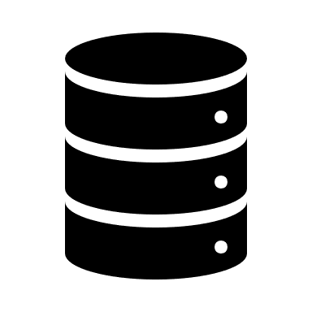
Web Applications
javascript, HTML5, CSS
Python, Java
get request
post request
Webpage
webserver
application server
database

Slide 4
Benefits of web apps
Allowing multiple users access to the same version of an app
No need for local machine installation
Accessible across multiple platforms
Typically, not browser dependent
Does not use up local resources such as memory or computing power

Slide 5
What is Django?
Django is a popular Python library that is used to build web apps
Django is a server-side web framework that encompasses *all the elements that can help build interactive website
For this project we will create a Learning Log – an online journal system that lets you keep track of information you’ve learned about particular topics.

Slide 6
Django

Slide 7
The Learning Log Project
Define models for the data to work with
Write views and templates so Django can build the site’s pages
Respond to page requests
Read/write to a database
Manage users
And more!

Slide 8



Get Set Up
Create a new folder named Django
Create a virtual environment – django_venv
Activate the VE
Install the Library

Slide 9

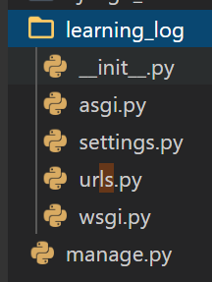
Create the Django Project
This will create a new project called learning_log
It is important to remember the ‘.’ at the end of the line
The dot at the end of the command creates the new project with a directory structure that will make it easy to deploy the app to a server

Slide 10


Creating the Database
Django stores most of the information for a project in a database
Typically the migrate command is used to modify a database. If it is used for the first time, it creates a new SQLite database (db.sqlite3)
SQLite is a database that runs off a single file
Ideal for simple apps (such as ours), no maintenance or set up required

Slide 11

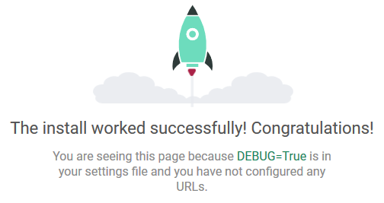
Viewing the Project
Verify that everything is set up correctly thus far
This starts a development server
Click on the server to check if it set up correctly

Slide 12
Viewing the Project
The URL http://127.0.0.1:8000/ indicates that the project is listening for requests on port 8000 on your computer, also called localhost
The term localhost refers to a server that only processes requests on your system; it doesn’t allow anyone else to see the pages you’re developing
To stop the server, press CTRL-C in the terminal window

Slide 13

Create a debugger launch profile
You're probably already wondering if there's an easier way to run the server and test the app without typing python manage.py runserver each time.
You can create a customized launch profile in VS Code, which is also used for the inevitable exercise of debugging.
Switch to Run view in VS Code (using the left-side activity bar).
Select the gear icon and wait for a few seconds for VS Code to create and open a launch.json file.

Slide 14
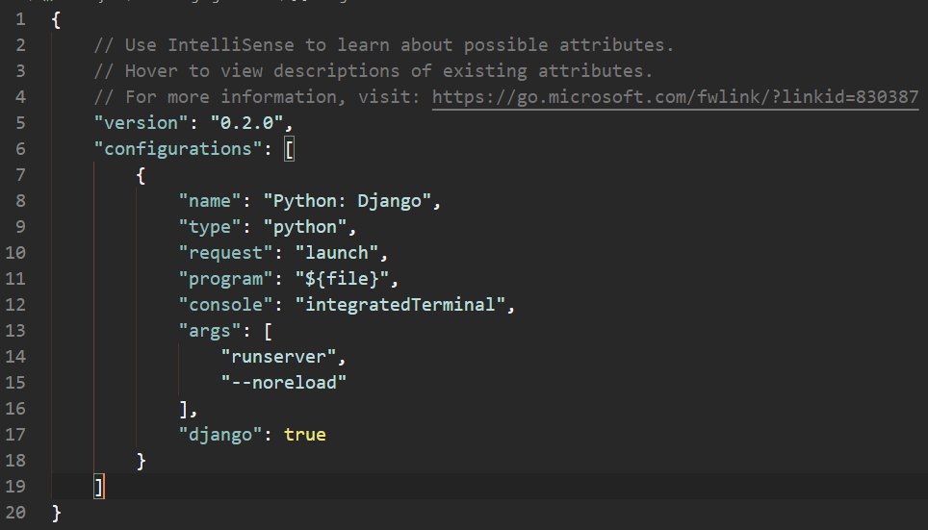
Create a debugger launch profile
the launch.json files should look like this:

Slide 15
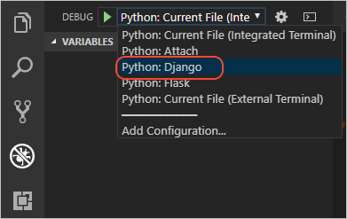

Create a debugger launch profile
save the launch.json file. In the debug configuration drop-down list (which reads Python: Current File) select the Python: Django configuration:
Test the configuration by selecting the Run > Start Debugging menu command, or selecting the green Start Debugging arrow next to the list (F5):
You can now use the Run > Start Debugging at any time to test the app, which also has the benefit of automatically saving all modified files.

Slide 16
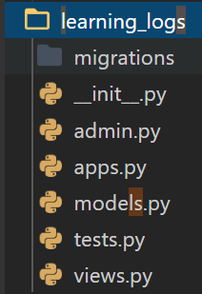
Starting an App
A Django project is organized as a group of individual apps that work together to make the project work as a whole.
For now, we will create just one app
This command creates the structure for an app
It will create a directory called learning_logs which has several files in it

Slide 17
Defining Models
A model tells Django how to work with the data that will be stored in the app
use models.py to define the data we want to manage in our app
For our project we want the user to be able to create a number of topics for their journal (learning_log).
So each entry will have a topic, text and timestamp
Code-wise, a model is just a class; it has attributes and methods

Slide 18
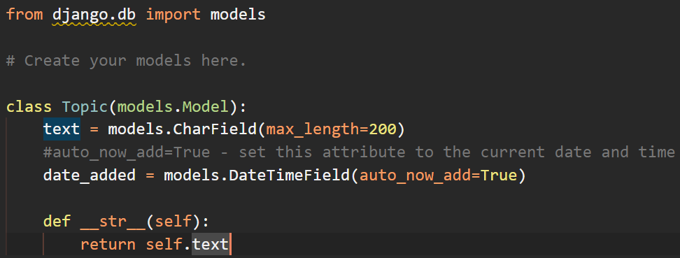
Defining the Model
For the entire list of fields - https://docs.djangoproject.com/en/2.2/ref/models/fields/

Slide 19
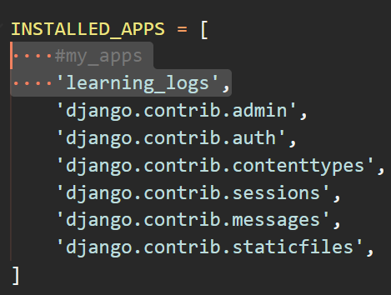
Activating the Model
Open settings.py to add the app we created

Slide 20

Storing the information
Modify the database to store information related to the model – Topic
This command creates a migration file that instructs the database to store any data associated with any new models
This command applies the changes in the migration file previously created

Slide 21
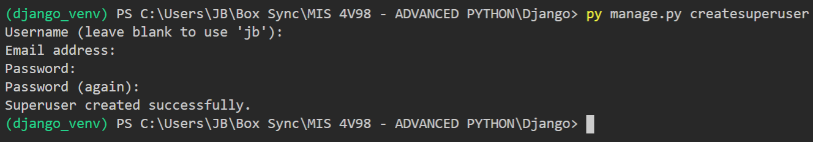
The Django Admin Site
You can easily work with your models in the admin site. Only an administrator should use this option. Not meant for general use
Create a super user that has access to all the information stored on the site

Slide 22
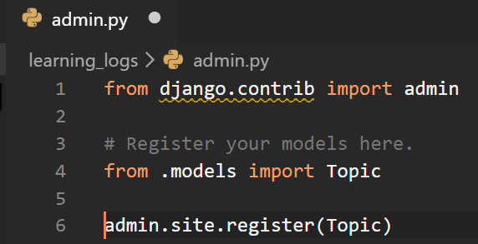
Registering a Model with the Admin Site
Django comes pre-built with the user and group models
To use the Topic model, we have to register it with the admin site
The dot in front of models tells Django to look for models.py in the same directory as admin.py
The code admin.site.register() tells Django to manage our model through the admin site

Slide 23
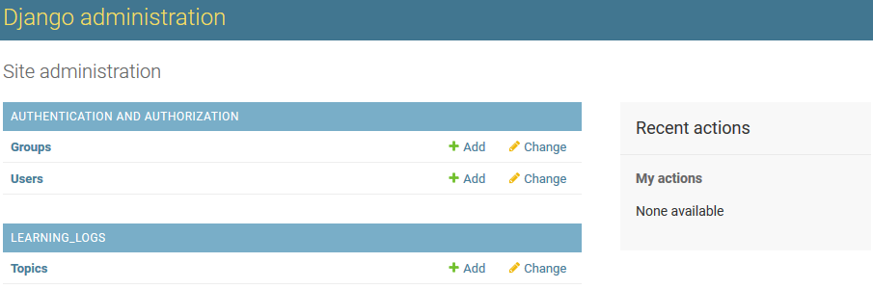
Admin Site

Slide 24
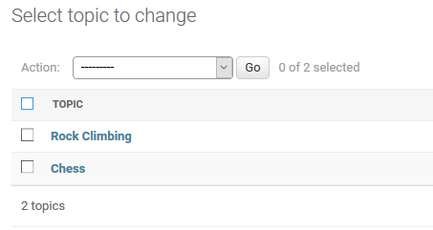
Adding Topics
Click Topics to go to the Topics page
Click Add Topic
Enter Chess in the first box and click Save
Add another topic – Rock Climbing
Verify the topics were created

Slide 25
Defining the Entry Model
For a user to record what they’ve been learning about chess and rock climbing, we need to define a model for the kinds of entries users can make in their learning logs.
Each entry needs to be associated with a particular topic
This relationship is called a many-to-one relationship, meaning many entries can be associated with one topic.

Slide 26
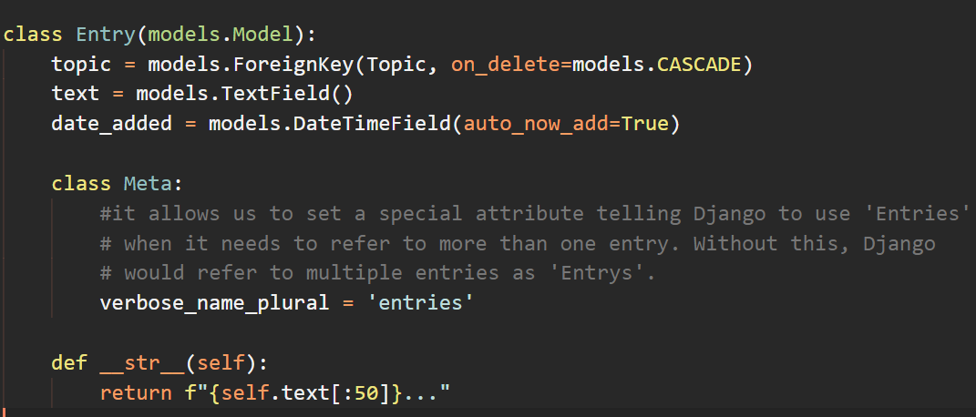
Defining the Entry Model
Exercise – Migrate and register the Entry model so it is accessible from the admin site (like we did for the Topic model)

Slide 27
Data Entry
Make an entry for Chess:
The opening is the first part of the game, roughly the first ten moves or so. In the opening, it’s a good idea to do three things—bring out your bishops and knights, try to control the center of the board, and castle your king.
Make another entry for Chess:
In the opening phase of the game, it’s important to bring out your bishops and knights. These pieces are powerful and maneuverable enough to play a significant role in the beginning moves of a game.
Make an entry for Rock Climbing:
One of the most important concepts in climbing is to keep your weight on your feet as much as possible. There’s a myth that climbers can hang all day on their arms. In reality, good climbers have practiced specific ways of keeping their weight over their feet whenever possible.

Slide 28
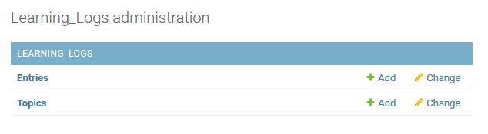
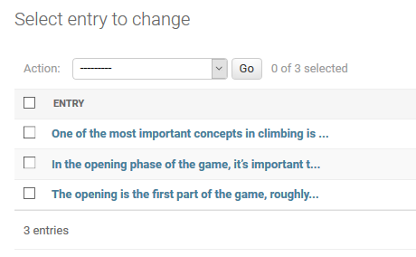
Data Entry

Slide 29
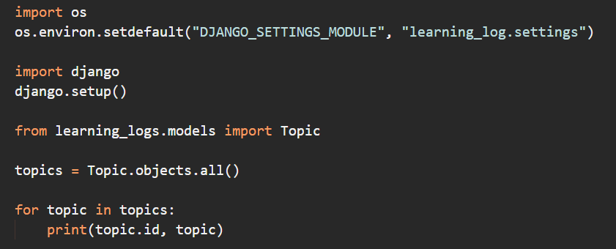

The Django Shell
we can examine that data programmatically through an interactive terminal session called the Django shell

Slide 30
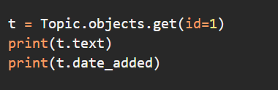

The Django Shell
if we know the ID of an object we can use the get() method to examine any attributes the object has.

Slide 31
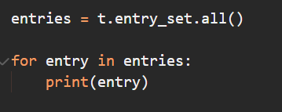

The Django Shell
We can also look at the entries related to a certain topic.
Since we defined topic as a foreignkey attribute in the Entry model, Django can use this relationship to access the entries for any topic
To get data through a foreign key relationship, you use the lowercase name of the related model followed by an underscore and the word set

